Slide 1
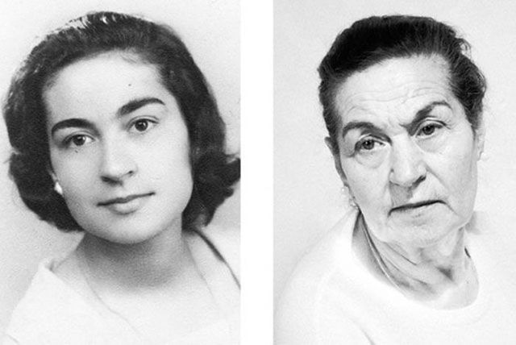
Why Do We Age?
The answer might lie in our DNA...
Notes:
Photo from: https://mymodernmet.com/ana-oliveira-identities/

Slide 2
DNA was established as the molecule of heredity
It needed to be: 1. Able to store information that pertains to the development, structure and metabolic activities of the cell
2. Stable so that it can be replicated
3. Able to undergo changes (mutations)
Some scientists felt that protein was the molecular of heredity, based on the fact there were 20 known amino acids.

Slide 3
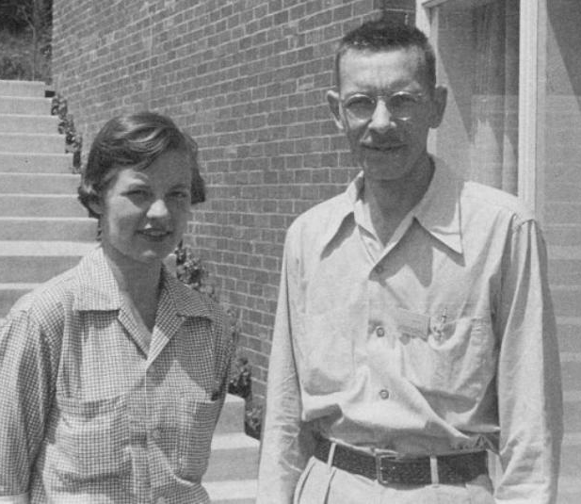
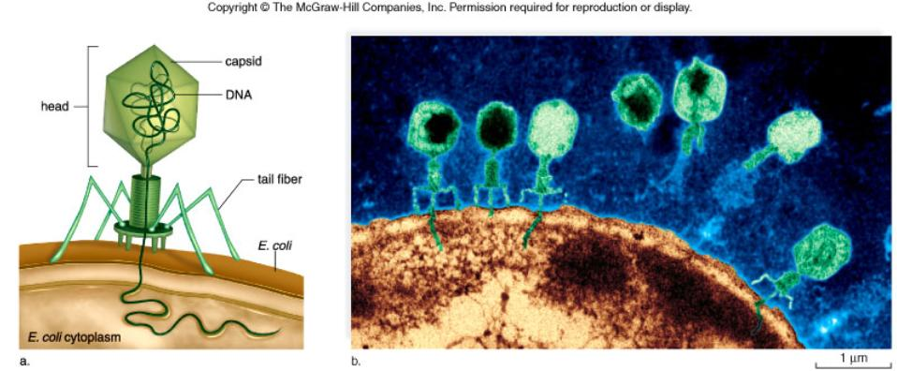
Alfred Hershey and Martha Chase Experiments
Experiments on bacteriophages finally showed that the molecule of heredity was DNA and not proteins.

Slide 4
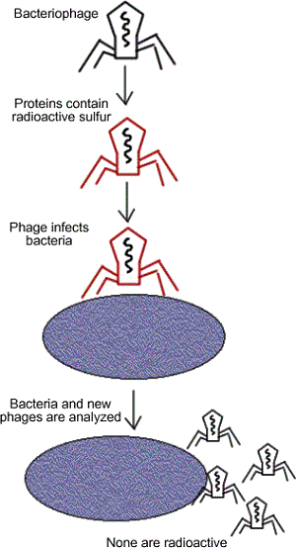
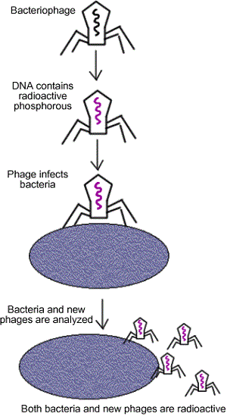
Conclusion: The radioactive tag on the DNA went into the bacteria, not the tagged proteins
Notes:
Animation of the Hershey and Chase Experiment

Slide 5
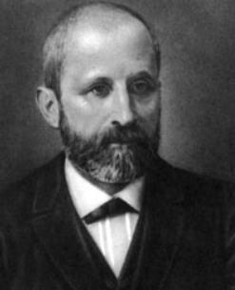
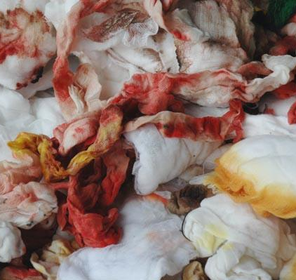
Funfac: In 1869, Swiss Physician, Johannes Friedrich Miescher isolated the chemical he called “nuclein” from the nuclei of white blood cells.
Now called nucleic acids
DNA (deoxyribonucleic acid)
RNA (ribonucleic acid)
Miescher used pus and blood stained bandages from a hospital to study “nuclein”

Slide 6
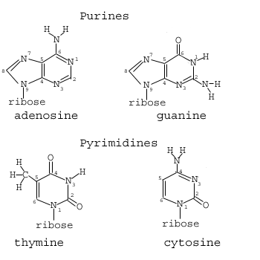
NUCLEOTIDES (found in nuclein)
Contain a sugar, phosphate and a nitrogen base
Nitrogen Bases
Adenine
Guanine
Cytosine
Thymine

Slide 7
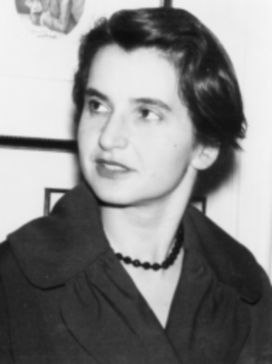
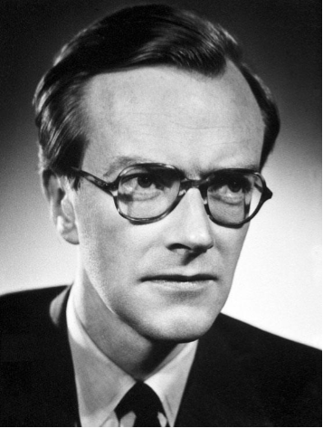
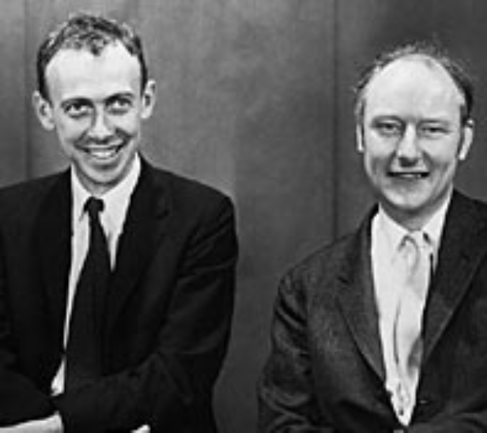
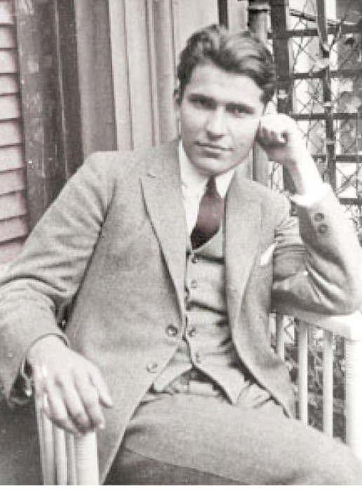
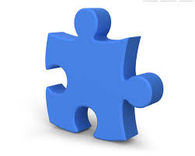
The Race to Establish the Structure of DNA
THE PLAYERS
THE PIECES
adenine
guanine
cytosine
thymine
deoxyribose
phosphate
Notes:
Rosalind Franklin, Maurice Wilkins, Watson, Crick, Chargaff
Watch HHMI Double Helix http://www.hhmi.org/biointeractive/double-helix

Slide 8
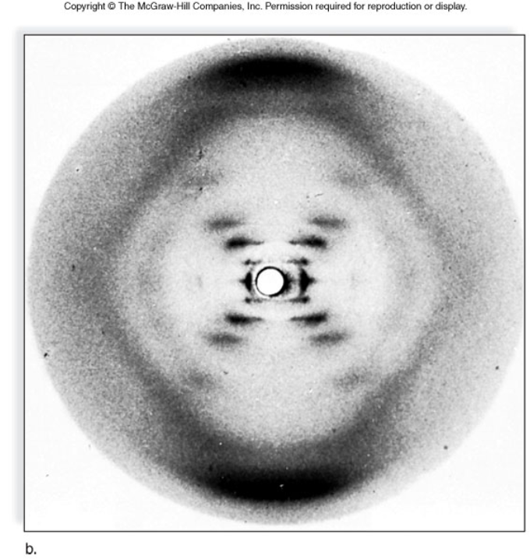
Photograph 51

Slide 9
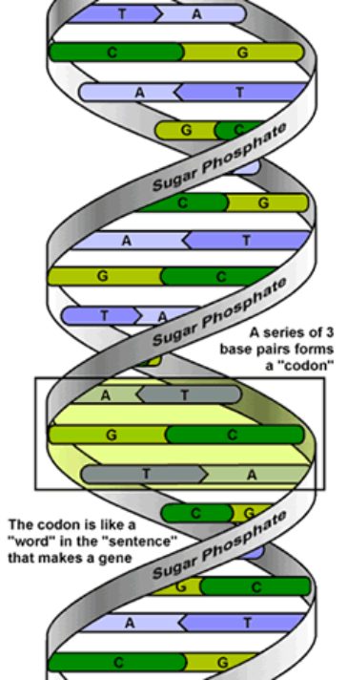
DNA: THE DOUBLE HELIX
Steps of ladder are bases (A, T, G, C)
Sides of ladder are sugar & phosphate
Both sides held together by hydrogen bonds

Slide 10
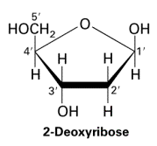
5' and 3' ends
5'
4'
1'
3'
2'
2'
3'
1'
4'
5'
Each side is antiparallel, the numbers represent the carbons attached in a ring to make deoxyribose

Slide 11
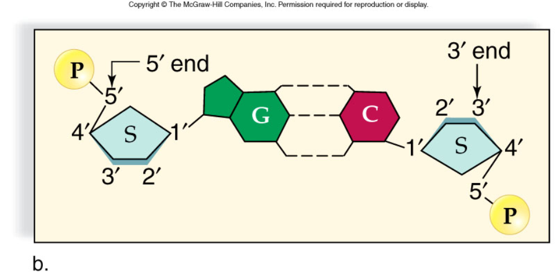
5’ and 3’ ENDS
Each Side is ANTIPARALLEL

Slide 12
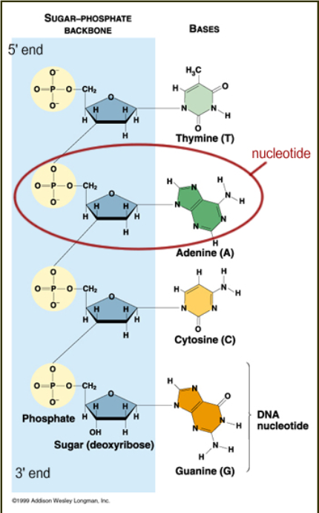
Nucleotide =
1 base
Deoxyribose (sugar)
1 phosphate

Slide 13
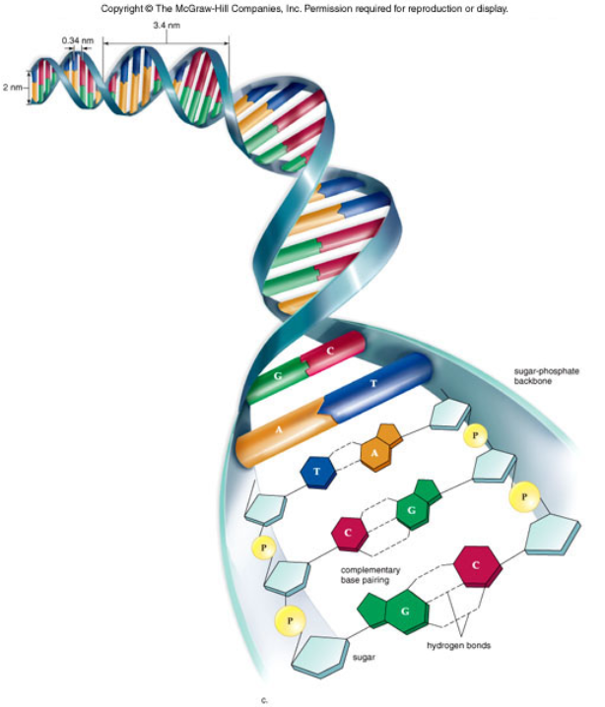

Slide 14
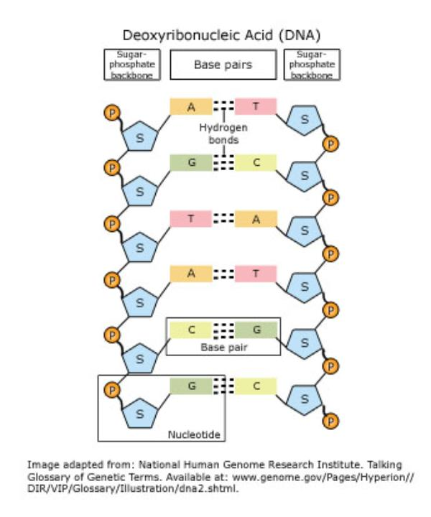

Slide 15
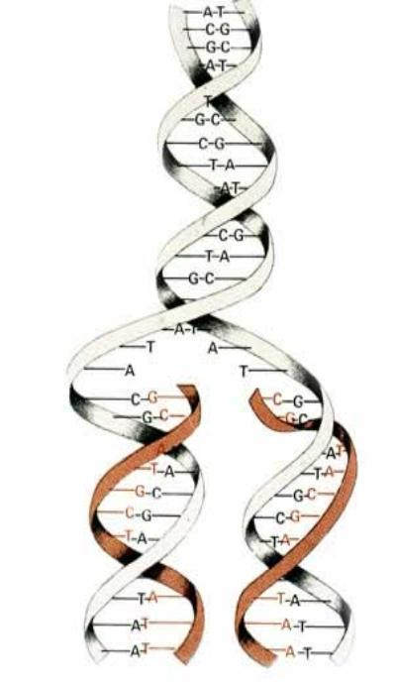
DNA REPLICATION
-the process by which DNA makes a copy of itself -occurs during interphase, prior to cell division
Replication is called semi-conservative, because one half of the original strand is always saved, or "conserved“

Slide 16
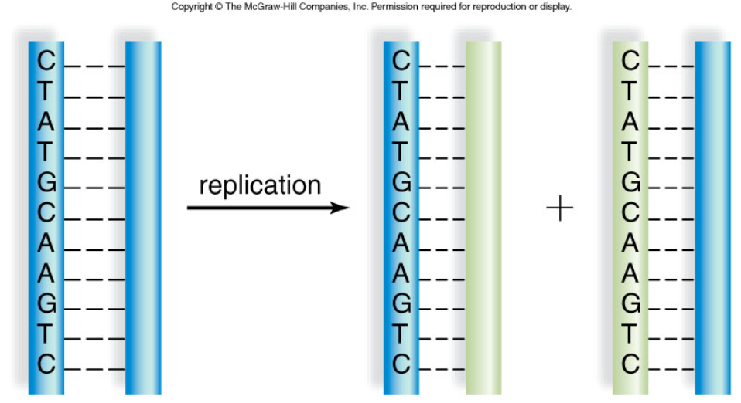
SEMICONSERVATIVE REPLICATION

Slide 17
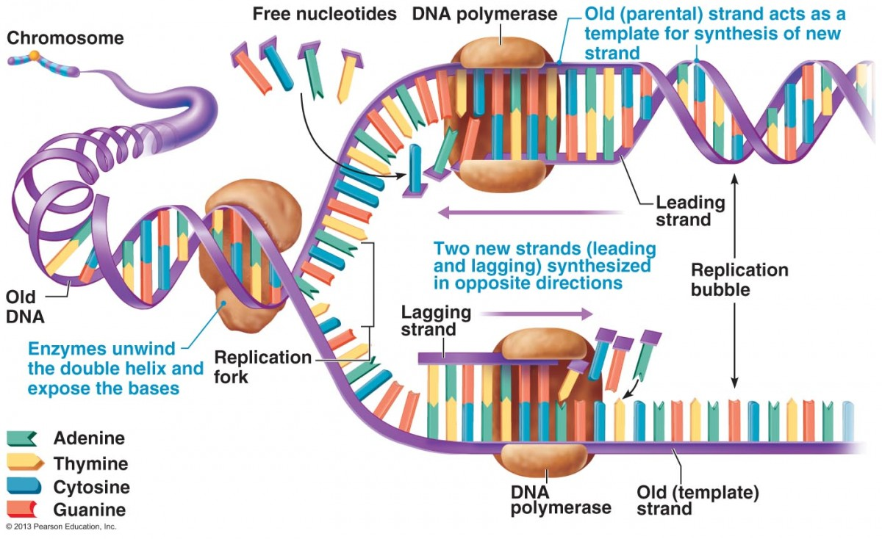
HELICASE
DNA LIGASE - binds fragments together

Slide 18
1. DNA helicase , replication fork.
2. DNA polymerase adds nucleotides and binds the sugars and phosphates.
***DNA polymerase travels from the 3' to the 5' end. The DNA is called the template strand.***
3. One side is the leading strand - it follows the helicase as it unwinds.

Slide 19
5. The other side is the lagging strand - its moving away from the helicase (in the 5' to 3' direction).
OKAZAKI FRAGMENTS are bound by DNA LIGASE
Problem: it reaches the replication fork, but the helicase is moving in the opposite direction. It stops, and another polymerase binds farther down the chain.
6. Multiple replication forks all down the strand.

Slide 20
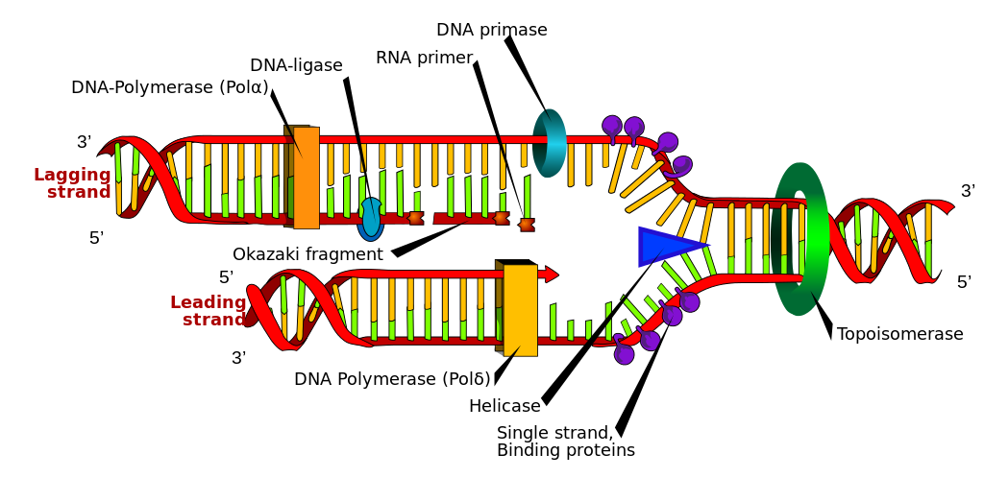

Slide 21
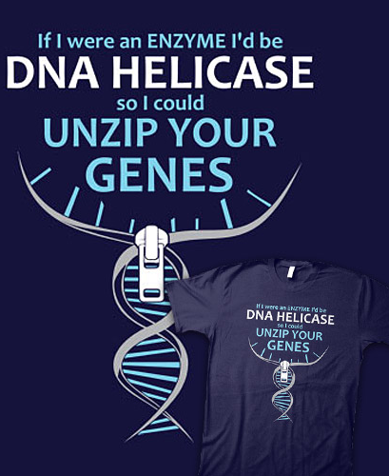
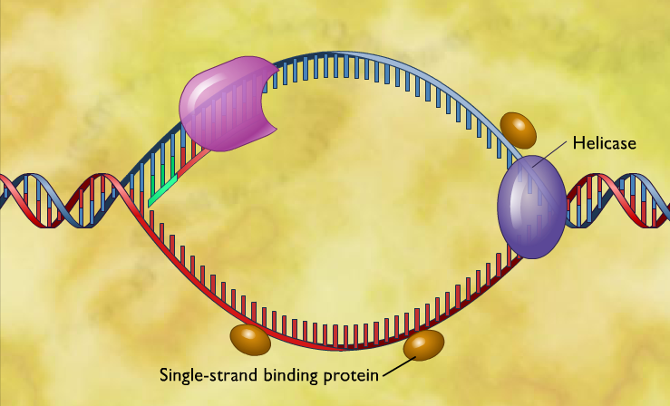
Animations and Videos of DNA REPLICATION
How Nucleotides are Added in DNA Replication (mcgraw-hill)

Slide 22
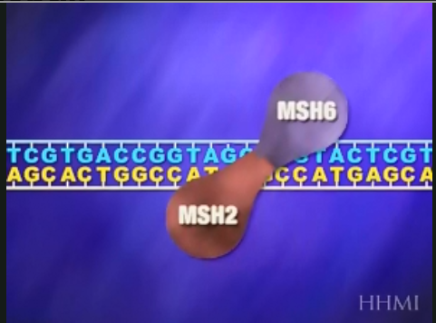
DNA can undergo changes - mutations
Repair molecules usually catch these random changes.
Types of Mutations:
1. Substitution (missense) - one base is switched, results in a new protein
2. Insertion or Deletion (frameshift) - alters the reading frame of the sequence
3. Duplication - can amplify the gene product 4. CNV - copy number variation (repeated sequences)
Notes:
http://www.hhmi.org/biointeractive/mismatch-repair

Slide 23
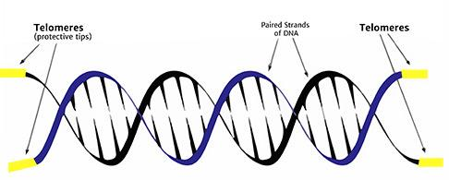
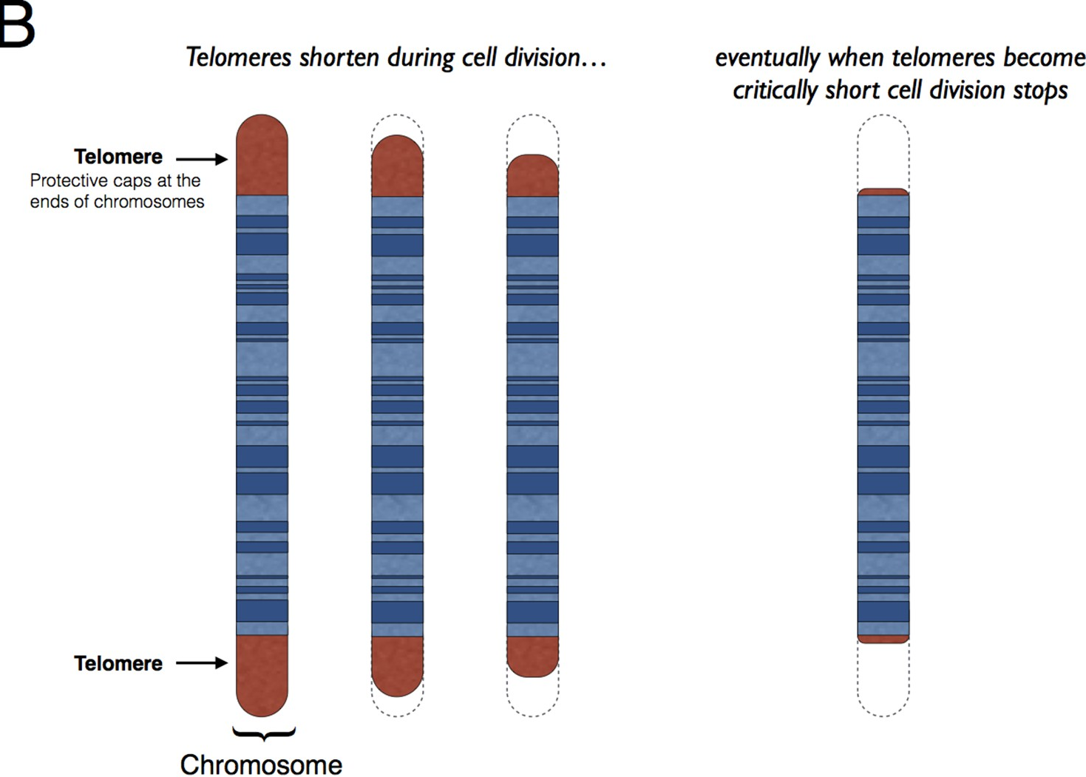
Telomeres
Telomeres are the caps at the end of each strand of DNA that protect our chromosomes, like the plastic tips at the end of shoelaces.
Telomeres get shorter each time a cell copies itself.
Eventually, they get too short to do their job, causing our cells to age and stop functioning properly
Telomeres act as the aging clock in every cell.

Slide 24
WORDS TO KNOW (REPLICATION
Helicase
Polymerase
Ligase
Replication Fork Okazaki fragments Semi-conservative Template Strand

